Slide 1
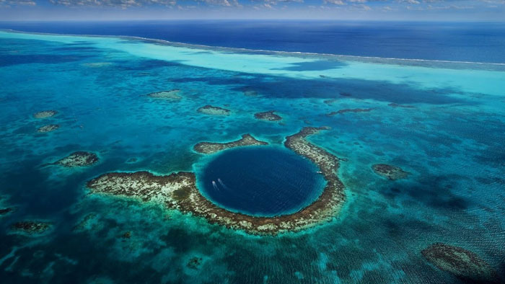
Mariana Expedition
Team Dragon
Notes:
SI

Slide 2
Team Dragon
Simon – Project Leader Frontend ,Audio Engineer, Concept Designer
Courtney – Project Leader Backend, Special Effects
Alex – Gameplay Programming/Mechanics
Becca – Asset Creation and Acquisition
Chris – Core Programming
Notes:
Si/
Hi, we are team dragon, my name is.... and....

Slide 3
Overview
Underwater adventure ​
Exploring the unknown​
Linear start then explorable area
Narrative
Notes:
Si/
The VR experience we have decided to create is this under water adventure
The Mariana trench, (Or challenger deep) is the deepest known place in the ocean . Located in the South-Asian sea.
90% of the ocean is still unexplored and we believe this is an opportunity to create a unique experience, that will be both awe inspiring and educational. Also to show people a side of the planet, they may not of known existed.
The player will be guided down, deeper and deeper, until at the bottom, in the dark, they are released and allowed to venture into the unknown of challenger deep.

Slide 4
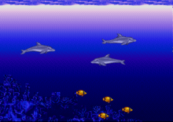
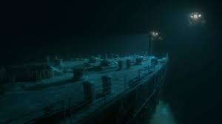
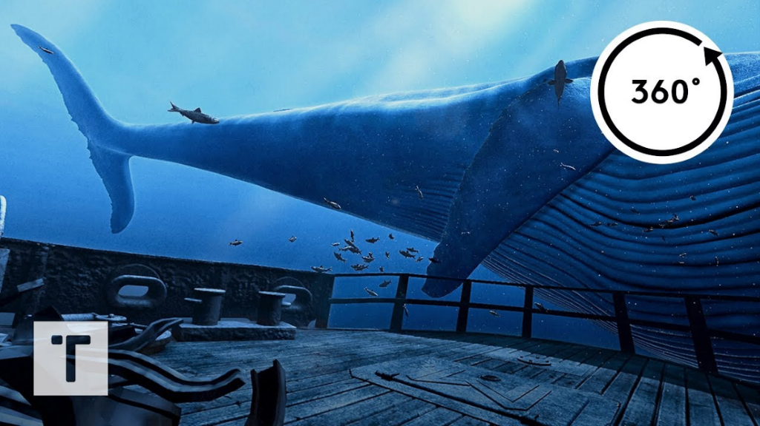
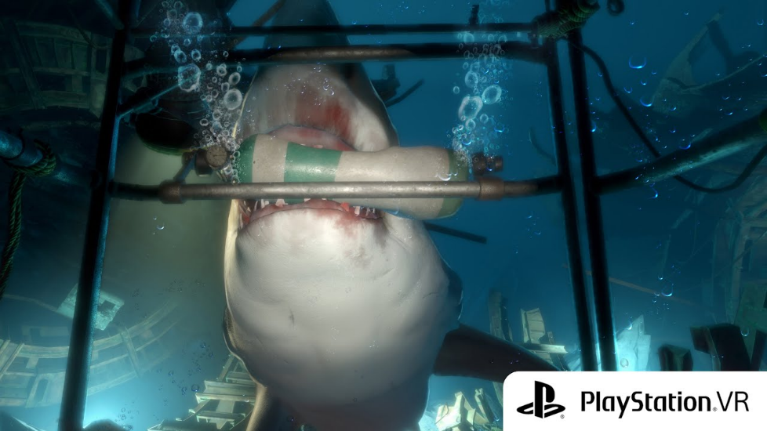
Influences
Notes:
Si/
Here are a few games I was influenced by for the concept of this Underwater adventure
Ecco – Sonar game made by Sega one of my favorite childhood games about sea exploration.
The next three pictures are from VR games and Experiences the Titanic experience
Into the blue, a liner VR experiences which you are a driver running on a spine.
And finally the depths a semi horror diving game, where you are trying to escape the Diving cage while a Shark circles.
All of these games have parts which I wanted to involve in our experiences from Ecco's Sonar, Titanic games use of lighting
Into the blue's use of Size and storytelling, and Into the depths use of space and shock and horror.

Slide 5
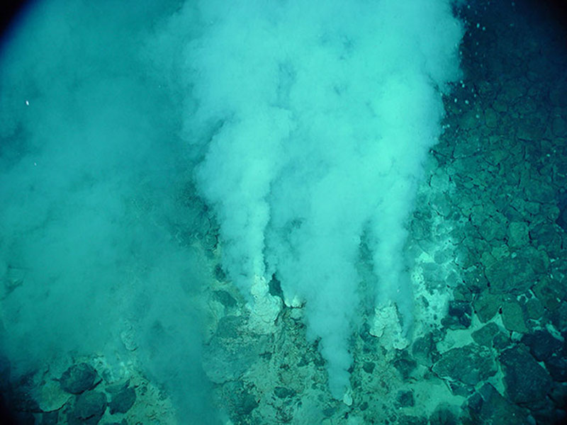
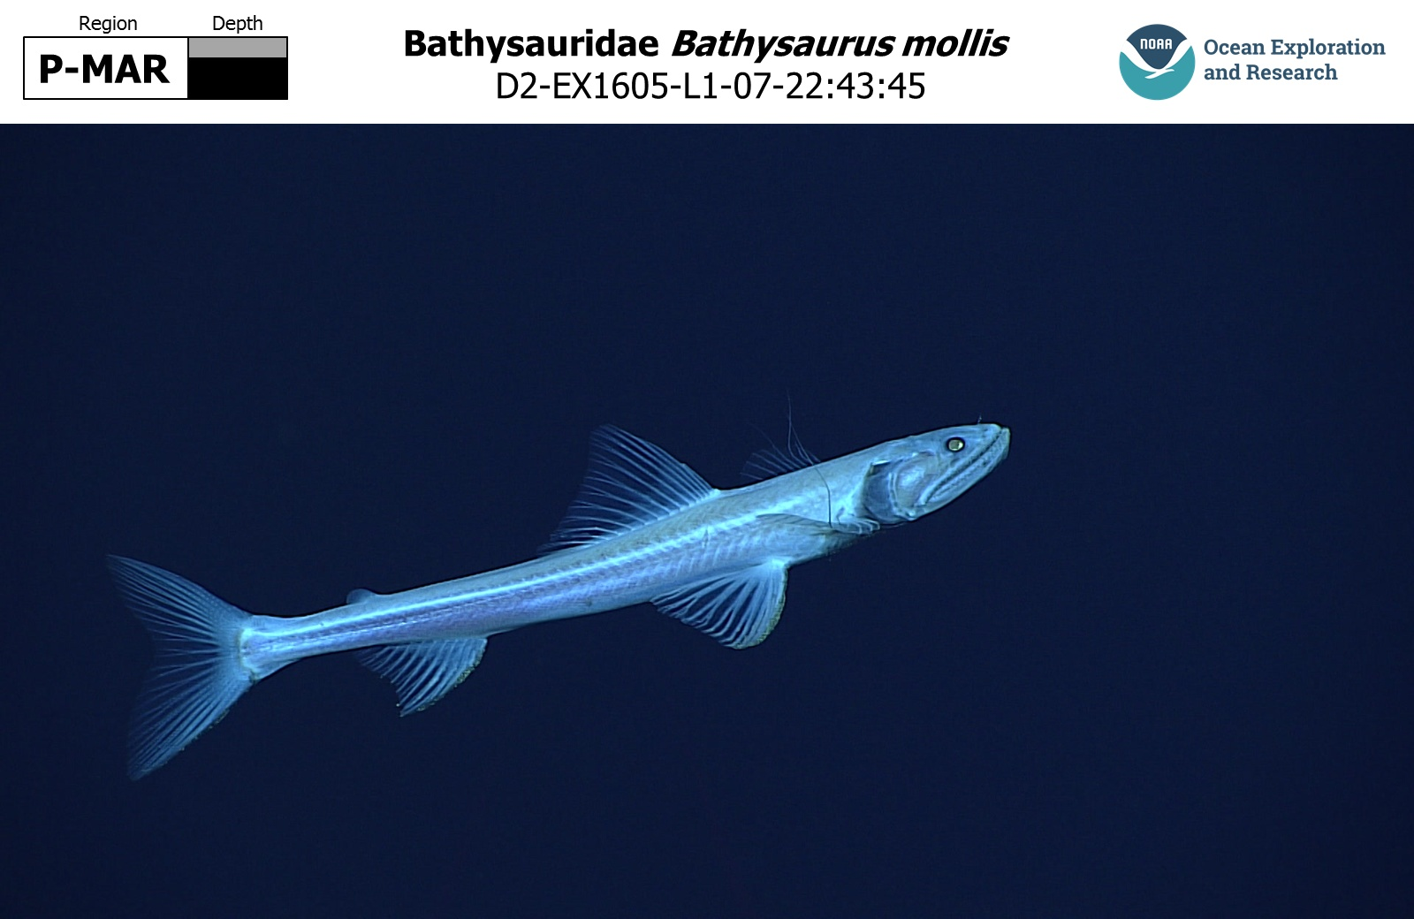
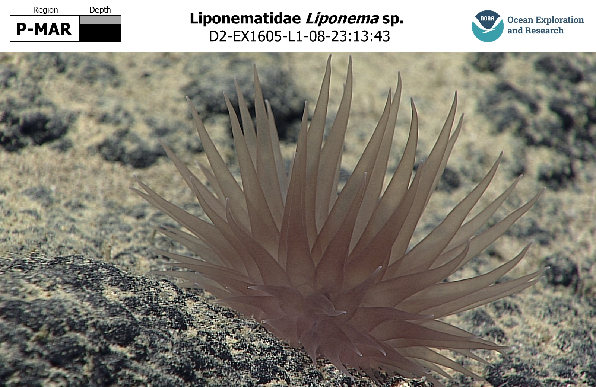
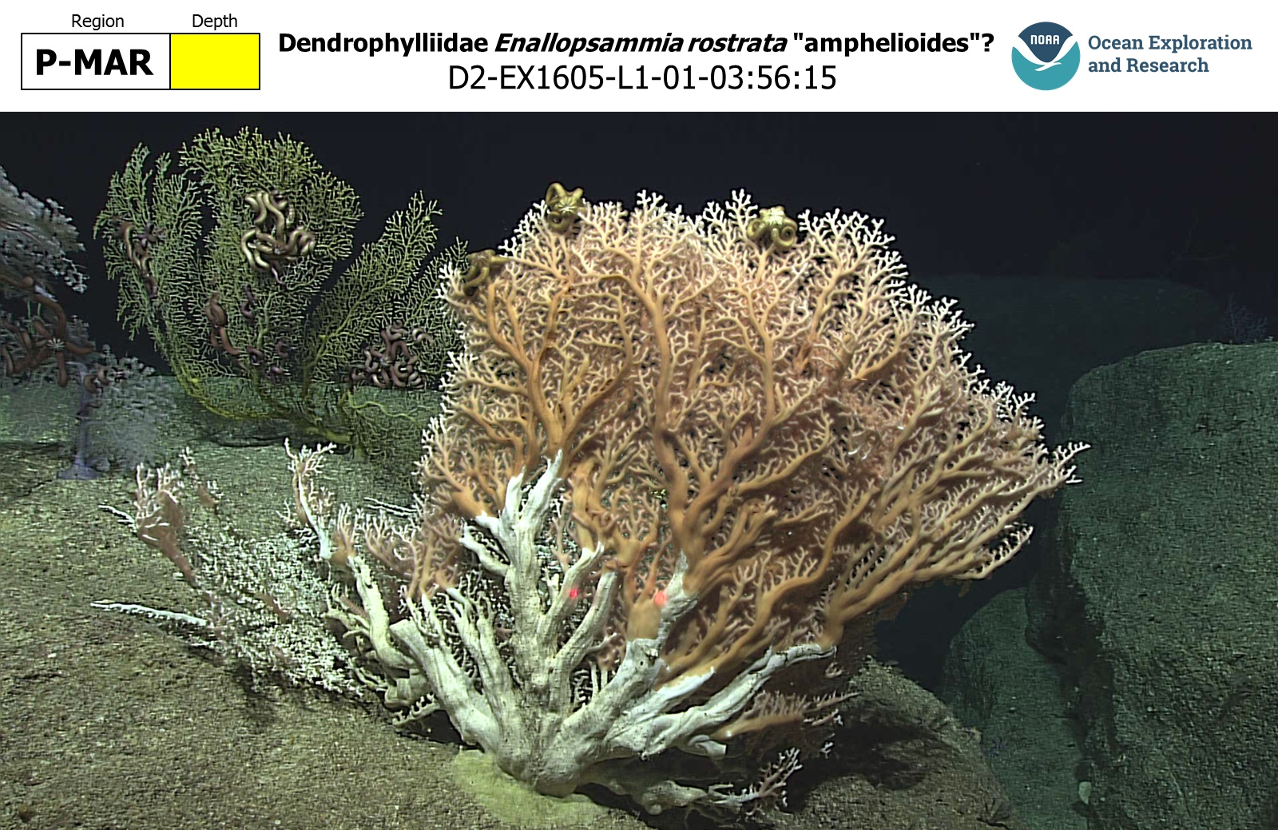
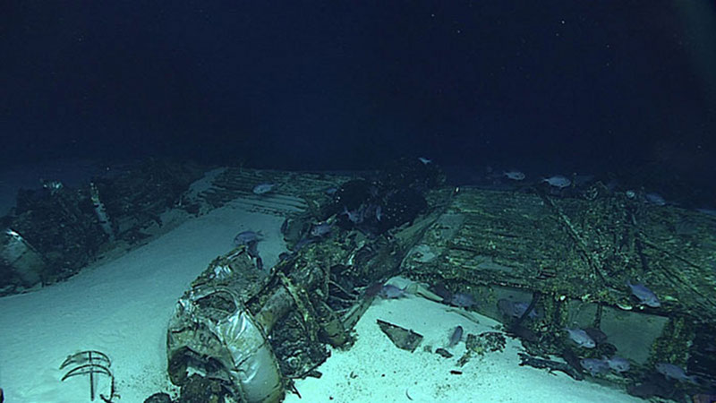
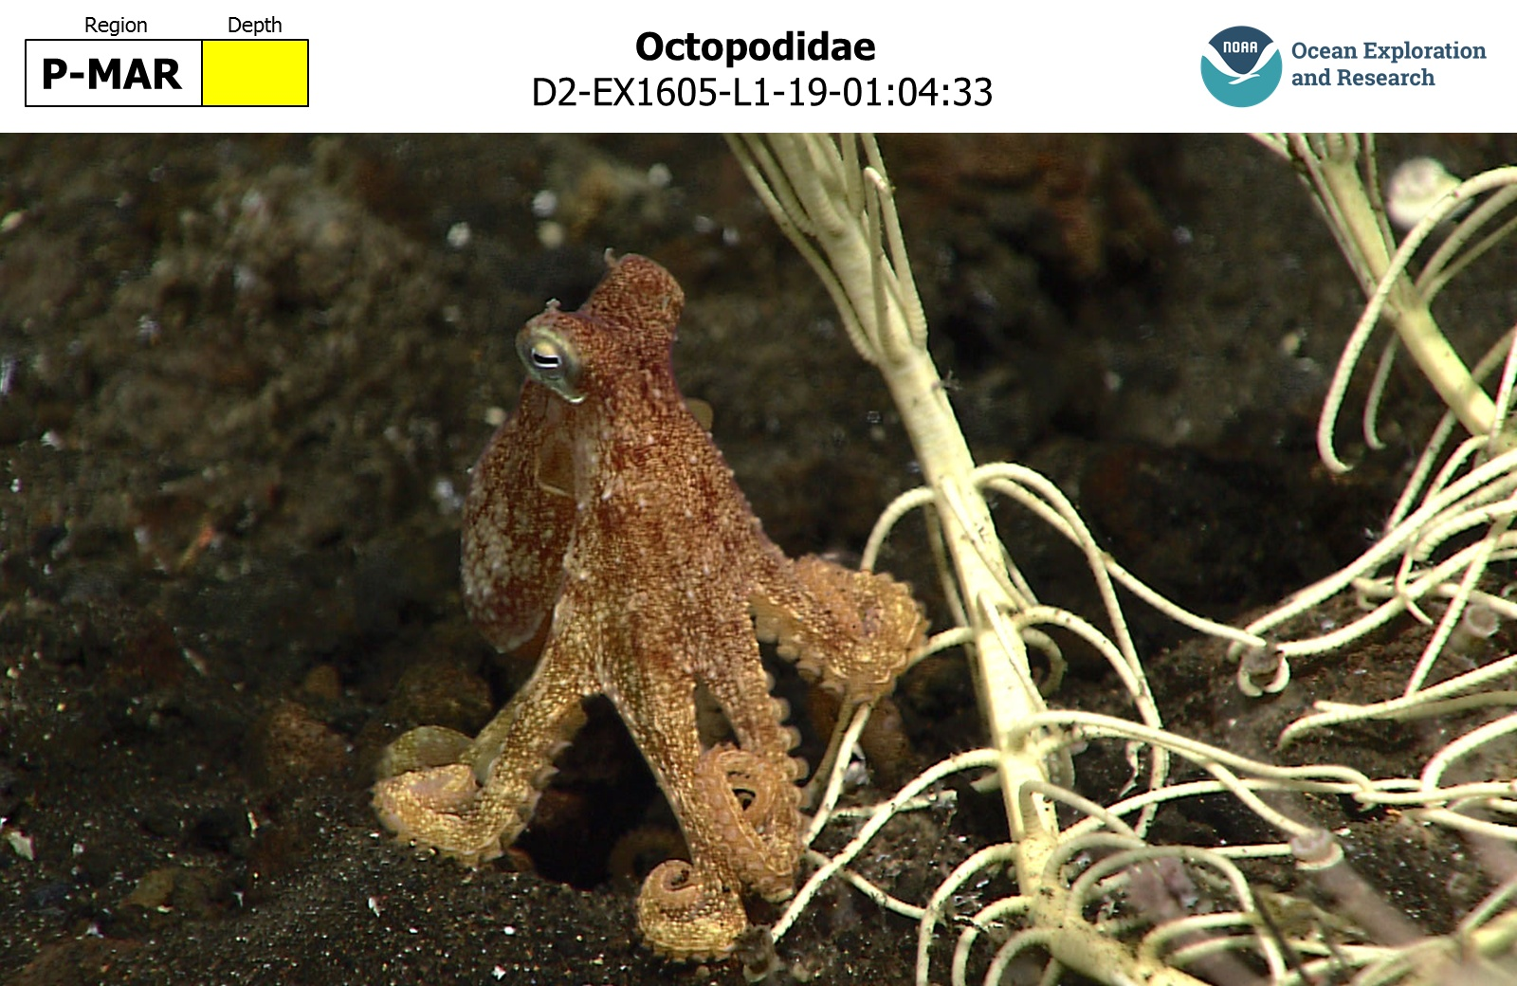
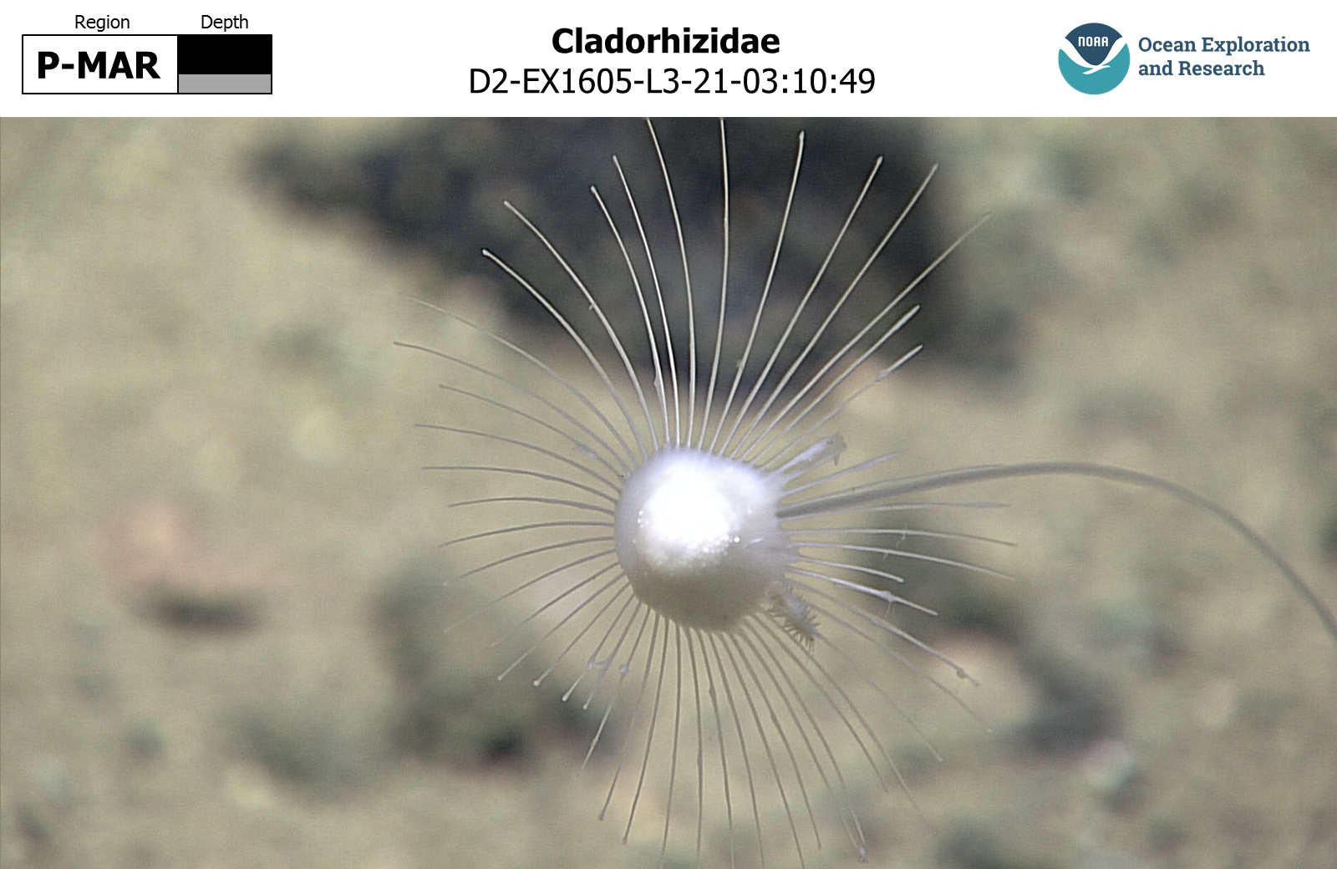
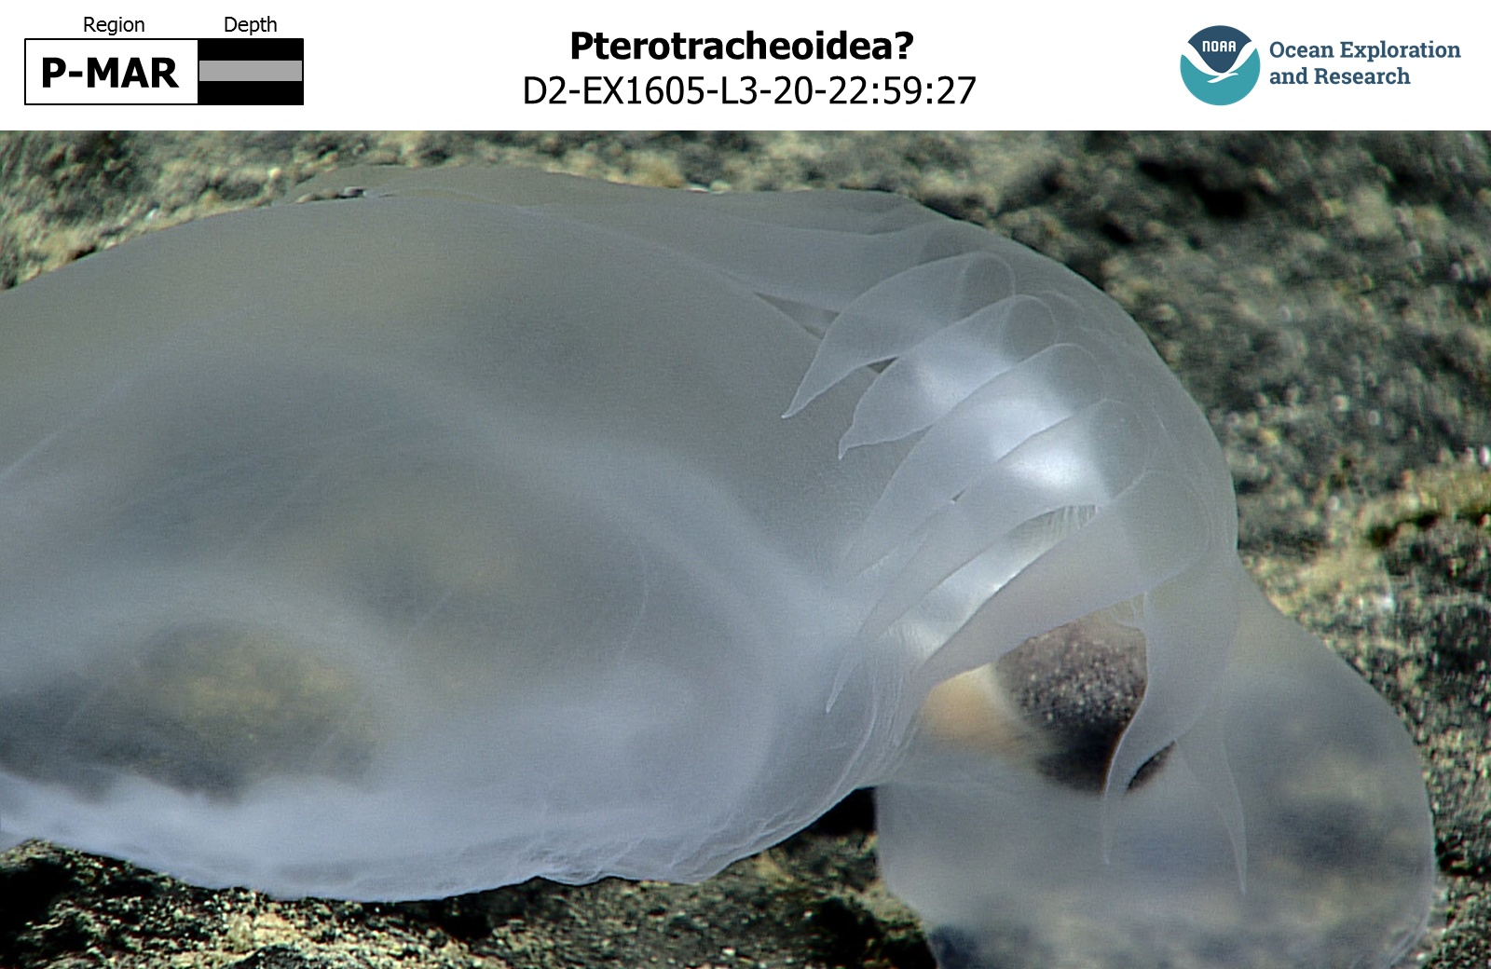
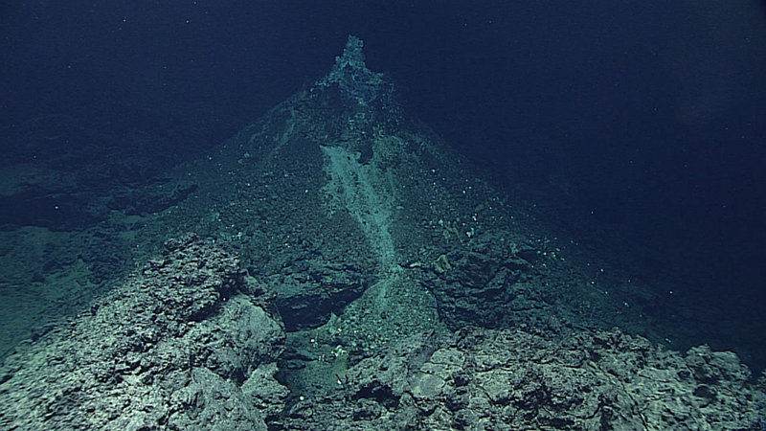
Mood board
Hydrothermal vent
Bathysaur / Highfin lizardfish
Octopus
Aircraft wreckage
Coral
Sea anemone
Sea snail
Sea sponge
Volcanic structure
Images sourced from: https://oceanexplorer.noaa.gov/okeanos/explorations/ex1605/welcome.html
Notes:
Becca
Vent - https://oceanexplorer.noaa.gov/okeanos/explorations/ex1605/background/vents/welcome.html - Hydrothermal vent in mariana known as "Champagne vent".
Aircraft - https://oceanexplorer.noaa.gov/okeanos/explorations/ex1605/logs/jul9/welcome.html - wreckage of a b29 superfortress used in WWII
Most images sourced from the National Oceanic and Atmospheric Administration expedition logs
Have found databases that contain a lot of images from expeditions, these identify the species and categerises them by which location they were found and how far down below the surface they were discovered. This could be very useful to us for ensuring we make the experience as accurate as possible.

Slide 6
User Perspective
Awake in submarine
Dropped into ocean (disconnect from ship)
Linear travel to bottom of Challenger Deep by winch
Land on bottom
Opportunity to explore the seabed
After a certain time, winched back up to surface.
Notes:
Court/
The player puts on the headset to find themselves sitting at the helm of a deep water exploration submarine.
They are then dropped into the ocean and slowly descend to their destination.
The camera fades in and out since this journey takes a long time in real life, and every time the fade in happens, the player has something new to sea
And is presented with real facts on what they are seeing
When the player lands at the bottom, they are given control over where to go next, the perspective will not include much of the interior of the sub, so the user can really look around.
We have a lot of things planned to be found and discovered at the sea floor.

Slide 7

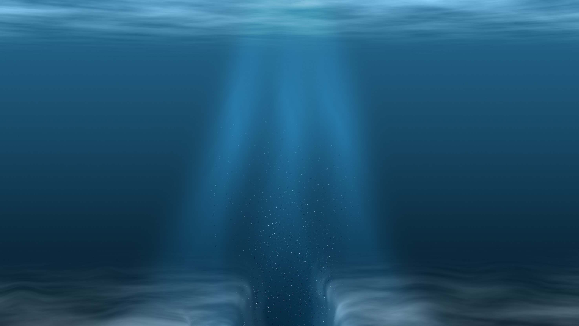
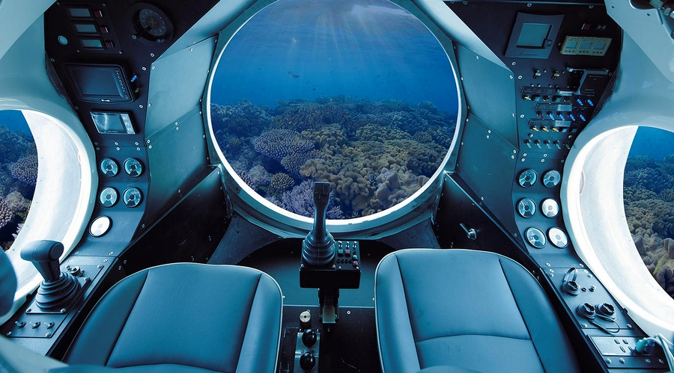
Aesthetics
Interior of Submarine
Underwater visuals
Sea Life
Fish
Shark
Squid
Sea cucumber
Coral
Seaweed/Sea Plants
Rubbish / wreckages
Notes:
Court/
Camera perspective is in the Interior of a submarine, to avoid motion sickness on the way down, and to immerse the player.
The deepest places in our sea can be very dark
Sea life will be seen more scarcely the further down you get
Other forms of life an phenomena will be seen further down however, maybe even rubbish as some has been sighted.

Slide 8
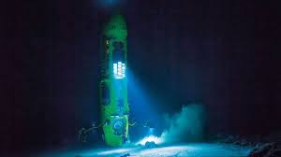
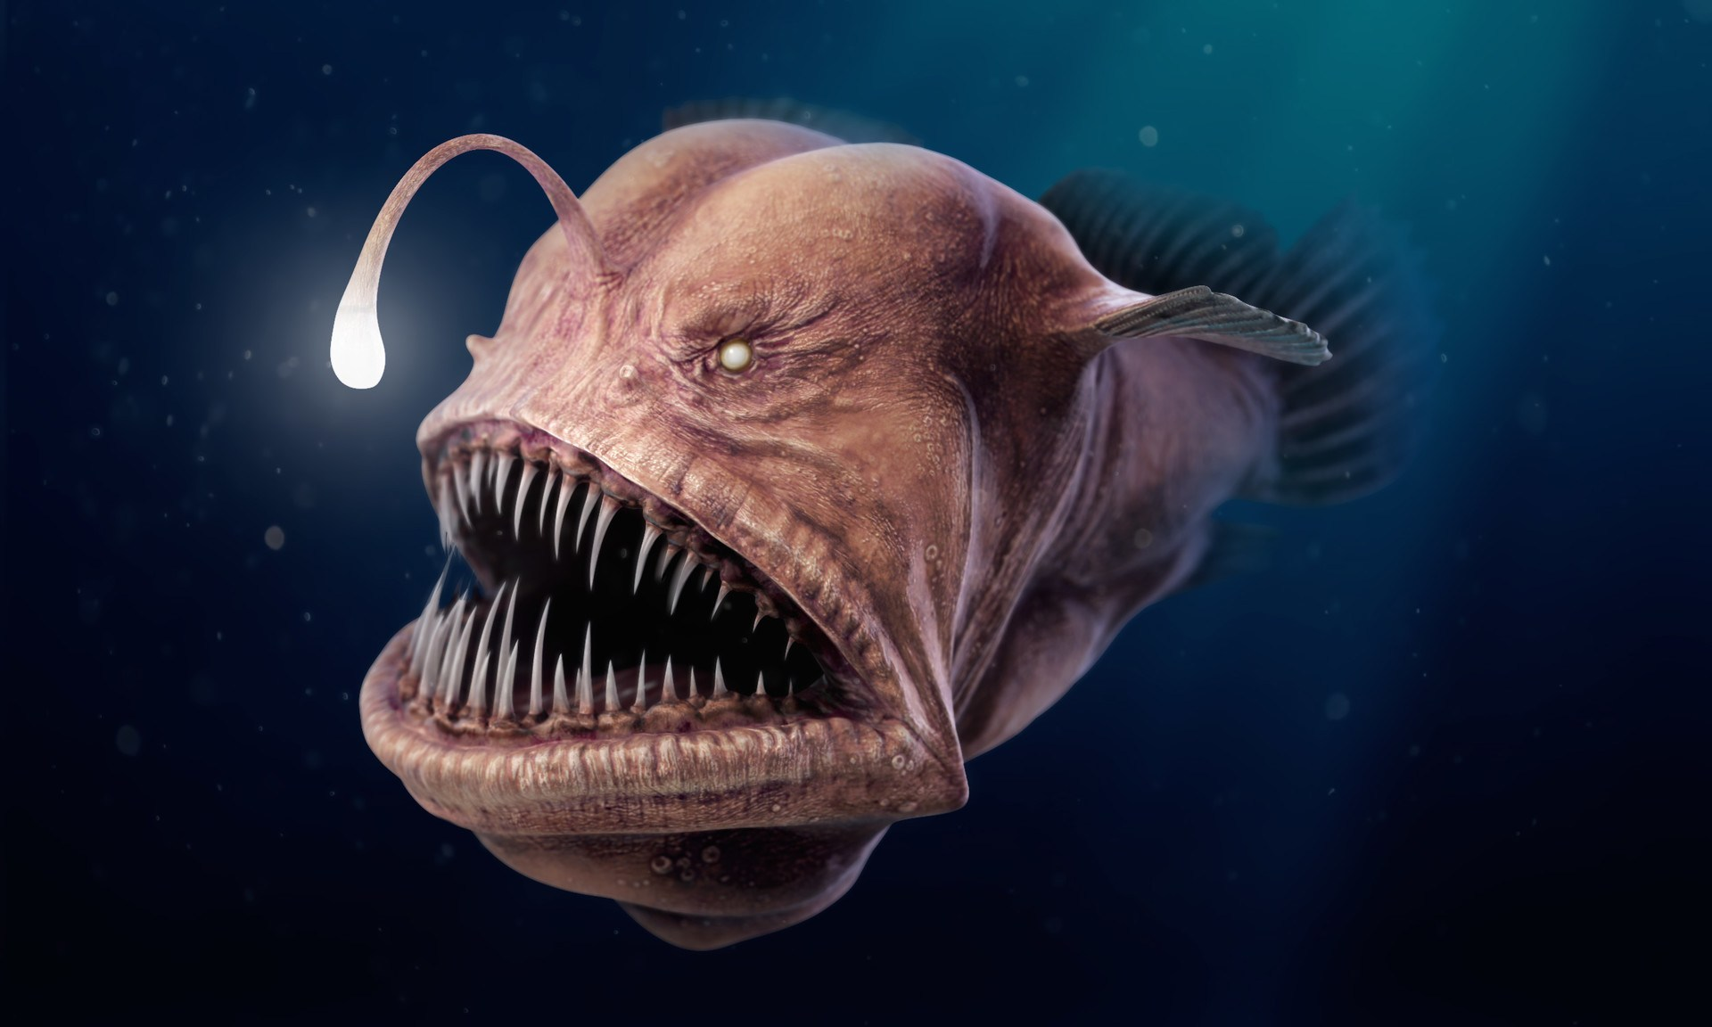
Research
Sea-life in the area
Underwater sound
Mariana trench
Submarines
Physics in water
Pressure
Lighting underwater
Notes:
Court/
In our research we have found, that:
The trench has protection status, being recognized as the Marianas Trench Marine National Monument protects approximately 95-thousand square miles of submerged lands and water
The Angler fish, a creature that uses a bioluminescent protrusion to attract its prey.
The bottom of the ocean is also extremely dark, with water pressure being really high.
https://www.marianatrench.com/mariana_trench-biology_001.htm
https://headsup.boyslife.org/scariest-animals-earth/

Slide 9
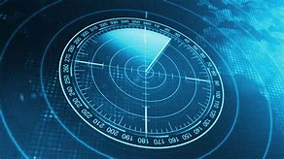
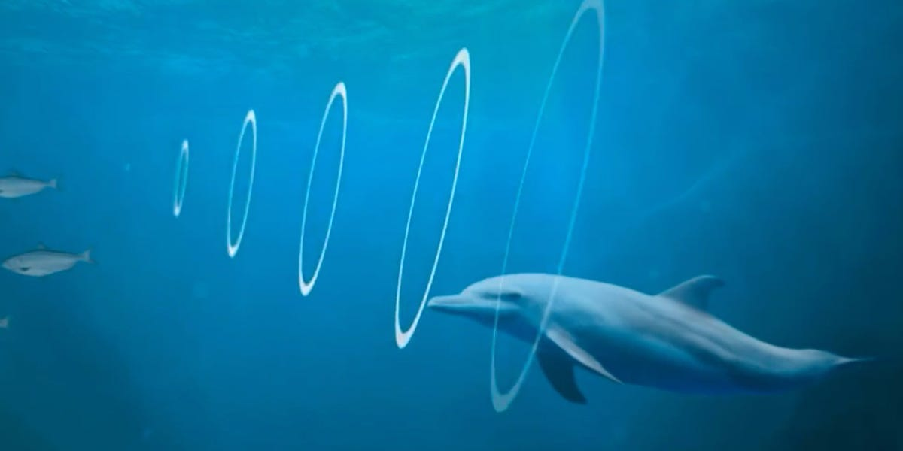
Sound
Heavy focus on sound
Immersion
Sounds will be made
Using the Foley method
Sounds will be collected
Freesounds.org
Attempt some voice acting
Will be tested
Notes:
/Si
-Submarine sounds
-Engine
-Boat above (motor)
-Movement through water
-Radio comms (Voice acting)
-Sonar
-Winch movement
-Pressure sounds
-Bubbles
-Sea life
-Whales
-Fish
-Splashing sounds near surface
-Narrator (Voice acting)
Foley is a unique sound effect technique that involves creating and “performing” everyday sounds for movies and television shows. Foley artists create these sounds in a recording studio during post-production, in synchrony with the picture, to enhance the quality of the audio

Slide 10
Mechanics
Spline Movement system
Button interactions
Toggle lights on/off
Movable sub
Sit down experience, on a rotatable chair
Physics in water
Sound in Water
Sonar
Notes:
/Chris
Lowering the Ship on spline, then changing the system onto on ground movement
Sensing of pressed buttons via pointing and putting hand on
Toggle lights on/off
Movable sub by putting your hand onto a button on each side of the ship (Possibly additionally move via pivot of the camera)
Sit down experience, on a rotatable chair
Physics in water i.e. don't start/stop movement instantly (momentum)

Slide 11
What we aim to achieve
Educational
Introduce new users to VR
Promote deep sea exploration.
Develop a high quality, highly researched VR experience.
Notes:
/Alex
Educational view for children and young adults interested in Marine biology, this experience would be accounted as a rare Experience.
Introduce new users to VR and establish an interest for new and experienced users.
Promote deep sea exploration.
Develop a high quality, highly researched VR experience.

Slide 12
What makes this project unique?
Immersive experience .
Focus on adventure and education.
Underwater adventure based on realism.
Making a rare experience accessible.
Notes:
Alex

Slide 13
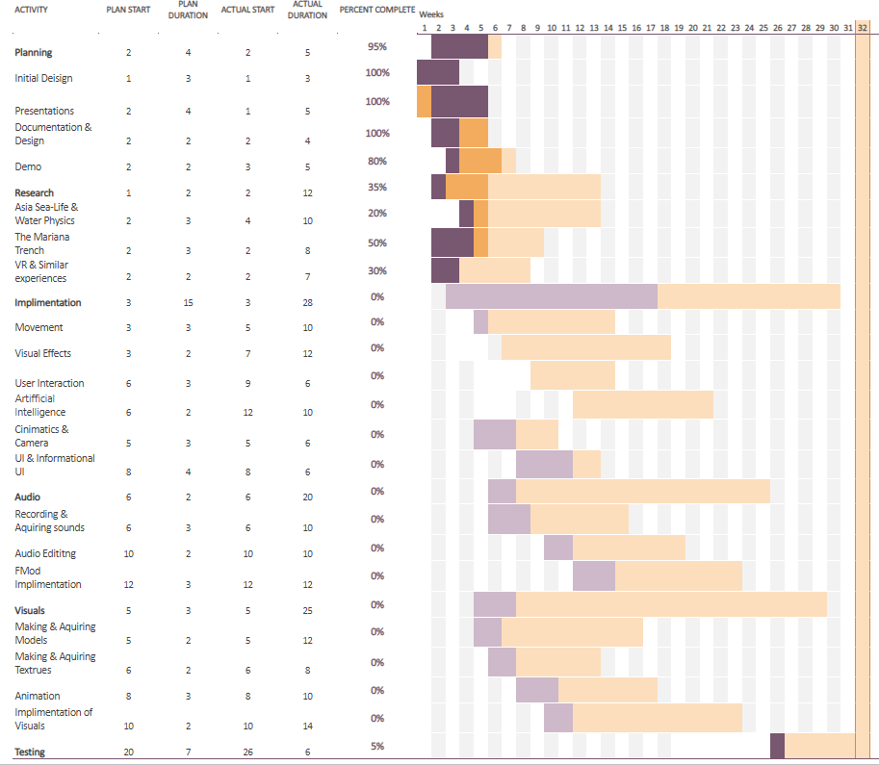
Time plan
Notes:
/court

Slide 14
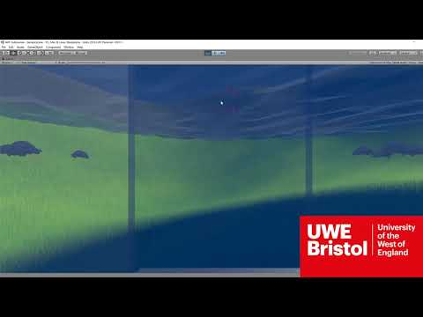
Demo
Notes:
/Kris

